Slide 1
Behavioral patterns
Continuous staff improvement project
Rami Atieyeh

Slide 2
Introduction
Introduction
Observer
Strategy
Template method
visitor

Slide 3
introduction
Concerned with algorithms and communication between them.
The operations that make up a single algorithm might be split up between different classes, making a complex arrangement that is difficult to manage and maintain.
The behavioral patterns capture ways of expressing the division of operations between classes and optimize how the communication should be handled.

Slide 4
observer
Role - Defines a relationship between objects so that when one changes its state, all the others are notified accordingly.
There is usually an identifiable single publisher of new state, and many subscribers who wish to receive it.
Example – blogs
Each blog site is maintained by a single blogger
People can subscribe to be informed each time a new blog entry is posted
The blogger alerts the subscribed parties

Slide 5
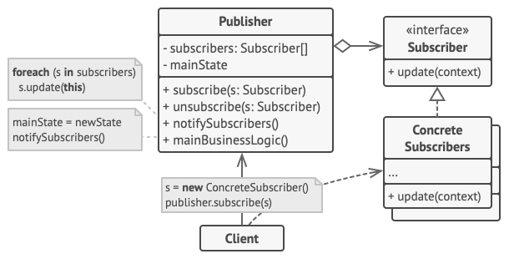
observer
Design – Composed of two classes.
Subject is the class whose objects change their state at an independent rate.
Observers may indicate they wish to be informed of these changes – in which case the Subject will send them notifications.
Observers can subscribe and unsubscribe from notifications at will.

Slide 6
observer
Subject has Notify() method – gets activated whenever the state of Subject changes – sends its state to the Update() methods inside the Observers.
These Observers have been already registered with the Subject via Attach() method.
Summary
Subject – The class whose instances independently change their state and notify Observers
IObserver – An interface for Observers specifying how they should be updated
Observer – A class that provides an Update method to enable its instance’s state to stay consistent with the Subjects.
Update - The operation that forms the interface between the Subject and the Observers
Notify - The event mechanism for calling the Update operation on all Observers

Slide 7
observer
Example in Visual Studio
Note - Each Observer may use the Sbuject’s State differently
Used when
There are aspects to an abstraction that can vary independently.
Changes in one object need to be propagated to a selection of other objects,
The object sending the changes does not need to know about the receivers.

Slide 8
strategy
Role - Removing an algorithm from its host class and putting it in a separate class.
If the algorithms are all kept in the host, messy code with lots of conditional statements will result.
Enables a client to choose which algorithm to use from a family of algorithms and gives it a simple way to access it.
Example – Choosing an algorithm for sorting data.
Sometimes, for specific situations, an algorithm performs better than the others

Slide 9
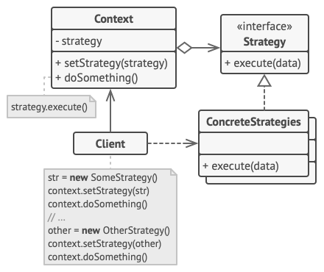
strategy
Design - An appropriate strategy is chosen from an available family of strategies.
Players
Context – A class that maintains contextual information for an IStrategy object’s algorithm to work on.
IStrategy – Defines an interface common to all the strategies.
StrategyA, StrategyB – Classes that include algorithms that implement the IStrategy interface.

Slide 10
Strategy
Example in Visual Studio
Used when:
Many related classes differ only in their behavior.
There are different algorithms for same purpose, and the selection can be codified.
The algorithm uses data to which the client should not have access.

Slide 11
Template method
Role - Enables algorithms to defer certain steps to subclasses.
The structure of the algorithm does not change, but small well-defined parts of its operation are handled elsewhere.
Example – Sorting algorithms
At some point, it will need to compare two items
The comparison differs according to the type of the objects being compared

Slide 12
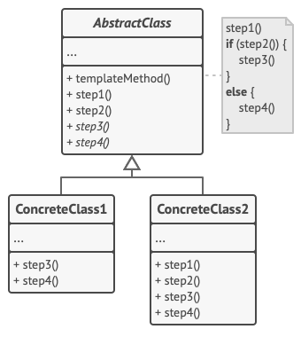
Template method
Design - An algorithm class that uses an IPrimitives interface to connect with methods defined in any class.
This class would typically handle data (as in the earlier sorting and searching example), but it could be purely behavioral itself.
Players
Algorithm - A class that includes a TemplateMethod.
TemplateMethod - A method that defers some parts of its operation to other classes.
IPrimitives - The interface defining the operation(s) that TemplateMethod defers to other classes.
AnyClass - Any class that implements the IPrimitives interface.
Operation - One of the methods that TemplateMethod needs to complete its operation.

Slide 13
Template method
Example in Visual Studio
Used when:
Common behavior can be factored out of an algorithm.
The behavior varies according to the type of a subclass.

Slide 14
visitor
Role - The Visitor pattern defines and performs new operations on all the elements of an existing structure, without altering its classes.
With the help of visitor pattern, we can move the operational logic from the objects to another class.

Slide 15
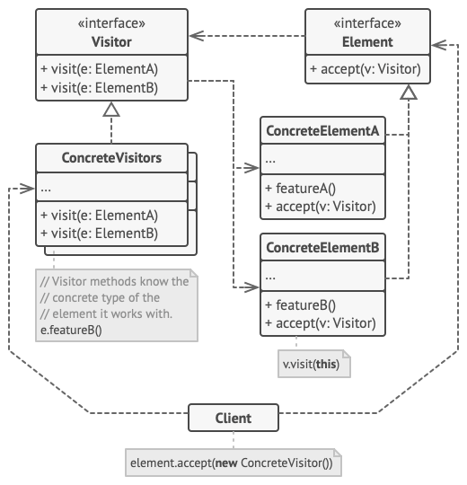
visitor
Design – Two distinct parts
Classes that make up an object structure
Methods that will be applied on the object structure
These methods are the visitors.
Note that the object structure is not necessarily a class hierarchy.

Slide 16
visitor
Client - A class that creates and maintains the object structure; instantiates and calls the Visitors.
ObjectStructure - A composite structure of several related element types.
Element - The root element type for the object structure.
ElementA and ElementB - Subclasses of Element.
IVisitor - An interface for all the Visitor classes.
Visitor1 and Visitor2 - Classes that contain methods that iterate through the object structure and apply operations to its elements.

Slide 17
visitor
Example in Visual Studio.
When used:
There are many distinct operations to perform on it.
You have a class hierarchy that is effectively sealed.
You need the flexibility to define new operations over time without modifying the Element interface.

Slide 18
Visitor
The benefit of this pattern is that if the logic of operation changes, then we need to make change only in the visitor implementation rather than doing it in all the item classes.
Another benefit is that adding a new item to the system is easy, it will require change only in visitor interface and implementation and existing item classes will not be affected.

Slide 19
assignment
Implement a real-life observer pattern example
TRADITIONAL MAILING SYSTEM – POST OFFICE, CLIENTS
ONLINE SHOPPING – STORE, CUSTOMERS
IMPLEMENT a real-life strategy pattern example
Convert one of the algorithm methods in a strategy into a template method

Slide 20
references
Bishop, Judith (2008). C# 3.0 Design Patterns
https://refactoring.guru/design-patterns/visitor
https://refactoring.guru/design-patterns/template-method
https://refactoring.guru/design-patterns/strategy
https://refactoring.guru/design-patterns/observer

